Slide 1
2019 POPCORN SALES INCENTIVES
Trail’s End
Amazon Gift Card
Mt. Adventure Rewards
College Scholarship
Council
Golden Ticket Scavenger Hunt
Chicago Wolves Ticket
Star Wars Movie Screening
Dave & Buster’s Experience
SkyZone Experience
And the Collection Patch
Pack
Pie-In-the-Face
Popcorn Bucks
Notes:
Bringing back Popcorn bucks - $10 for every $100 sold. To be used for any Pack or Council activity. –BH - Pack 671 will be trying out Popcorn Bucks. for every $100 sold a scout will earn $10 to be used on Pack activities. Popcorn Bucks can be used to pay for Scout's family at activities as well. Popcorn Bucks are "use them or use" and can not be carried over from Cub Scouts into Boy Scouts.

Slide 2
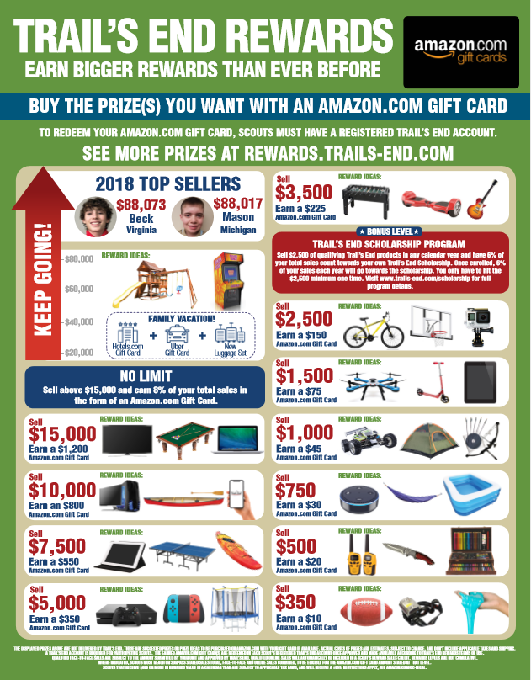
TRAIL’S END REWARDS
Buy the prizes YOU want with an Amazon.com Gift Card!
Check out the prize flyer for ideas and then build your Amazon.com Wish List.
Learn more at Rewards.Trails-End.com
August 12 – November 3
Earn one entry for every $100 in credit card sales (App + online sales) to qualify each week.
Weekly vacation giveaways and $10 Amazon.com Gift Cards.
Notes:
Council Prize Program - Trail’s End Scout Rewards
Amazon.com Gift Card rewards managed and digitally redeemed by Scouts through Trail’s End. 2018 Proven Results: Over 5,000 Scouts sold in an incentive plan using digitally redeemed gift cards with growth from 3.3% to over 11.6%!
Benefits for Scouts: • Can choose prize THEY want on Amazon. • No preset prize selection • Prizes for Sellers aged 5 to 18; male and female • Over 70% of households are Amazon Prime (free shipping). • Receive more reward value at every level. • Uncapped levels to incentivize top sellers to keep selling.
Benefits for units: • No collecting orders or distributing prizes. • Sales tracked by Scouts when selling with app and online. • Combined traditional and online rewards program – easy to communicate. • Submit for rewards when your unit is finished selling.
Build this up as BIG DEAL. Make sure that EVERY Scout gets a copy of the prize sheet on their way out the door. One of the game rotations should include marking down their prize goal on a roster.

Slide 3
TRAIL’S END REWARDS
Trail’s End College Scholarship Program
Sell $2,500
Sell $2,500 in any calendar year to have 6% of qualified product sales count towards their own Trail's End Scholarship. Once enrolled, 6% of sales each year will go towards a scholarship. Scouts must complete a scholarship form each year. Scholarship forms are due to NEIC for verification and signature by Friday, December 13, 2019. For additional information, see www.trails-end.com/ scholarship.
Funded By Trail’s End
*Enrollment and reporting of sales is not automatic. Forms must be submitted Dec. 13, 2019.
Notes:
You only have to hit the $2,500 minimum one time in any calendar year and receive 6% of your total sales invested in your own Trail’s End Scholarship account. Once enrolled, 6% of your sales each year will be added to your account. Online sales count!

Slide 4
COUNCIL INCENTIVES
Golden Ticket Scavenger Hunt
One golden ticket is hidden at a home in each district. The first Scout to sell popcorn at that home will be awarded a GOLDEN TICKET, which can be redeemed for two Sky Zone passes. Clues will be posted in weekly Kernel Journals and on the NEIC Facebook page at facebook.com/neicbsa. Golden tickets will be available until found or until the end of the sale.
Notes:
No clues yet
Golden Ticket Scavenger Hunt for Sky Zone Tickets
One golden ticket is hidden at a home in each district. The first Scout to sell popcorn at that home will be awarded a golden ticket, which can be redeemed for two Sky Zone passes. Clues will be posted in weekly Kernel Journals and on the NEIC Facebook page at facebook.com/neicbsa. Golden tickets will be available until found or until the end of the sale.

Slide 5
COUNCIL INCENTIVES
Collection Patch

Slide 6
COUNCIL INCENTIVES
Chicago Wolves Game
Sell $225
Sell $225 to earn one ticket to a Chicago Wolves game. Scout must be accompanied by one paying adult.

Slide 7
COUNCIL INCENTIVES
Special Screening of Star Wars: The Rise of Skywalker
Sell $850
Earn 2 movie passes (1 Scout/1 Adult) to a special screening of Star Wars: The Rise of Skywalker. Scouts may not attend without an adult.
*Time and location to be determined.

Slide 8
COUNCIL INCENTIVES
Dave and Buster’s Star Wars Battle Pod Experience
Sell $1,500
Earn a Dave and Busters Power Card with 125 Chips and play Star Wars Battle Pod.

Slide 9
COUNCIL INCENTIVES
Train like a Jedi and Reach for the Stars at SkyZone
Sell $2,500
Earn a 120 minute all access pass to Sky Zone to train like a Jedi.

Slide 10
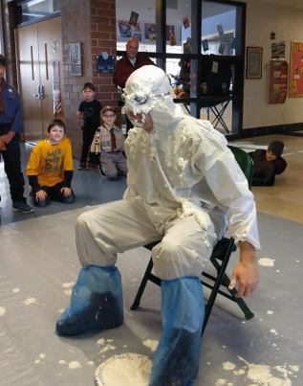
PACK INCENTIVE – Pie-in-the-Face
Sell $400
Earn a chance to throw a whipped cream pie into the face of our Assistant CubMaster!
* One pie per scout.
Sell $650
Earn a chance to throw a whipped cream pie into the face of our CubMaster!
* One pie per scout.
Notes:
This activity occurs in January during our Pack’s Pinewood Derby event.

Slide 11
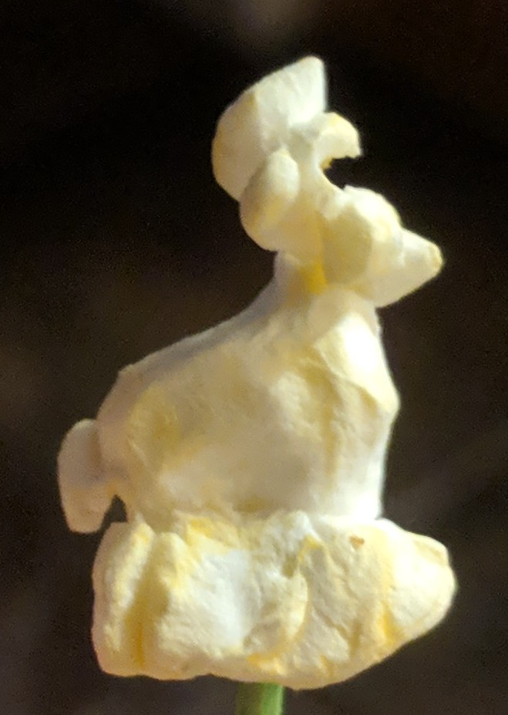
PACK INCENTIVE – Popcorn Bucks
$10 for Every $100 Sold
We’re bringing back Popcorn Bucks! For every $100 of popcorn you sell, you’ll earn $10 to be used for any Pack activity. Popcorn Bucks can be used to pay for Scout's family at activities as well. They are "use them or lose them“, as they must be used during this school year and cannot be carried over from Cub Scouts into Boy Scouts.

